Slide 1
Hands-On Machine Learning with Scikit-Learn & TensorFlow
Ana Maria Sandoval Jimenez, Jannis Busch & Sabrina Steinert

Slide 2

Chapter 8.
Dimensionality Reduction

Slide 3
OUTLINING
The curse of dimensionality
Two main approaches to DR*
Projection (e.g. linear PCA, Kernel PCA)
Manifold Learning (e.g. LLE)
Popular DR techniques
PCA
Kernel PCA
LLE
Other techniques
PPTX
JUPYTER
PPTX
*Dimensionality Reduction

Slide 4
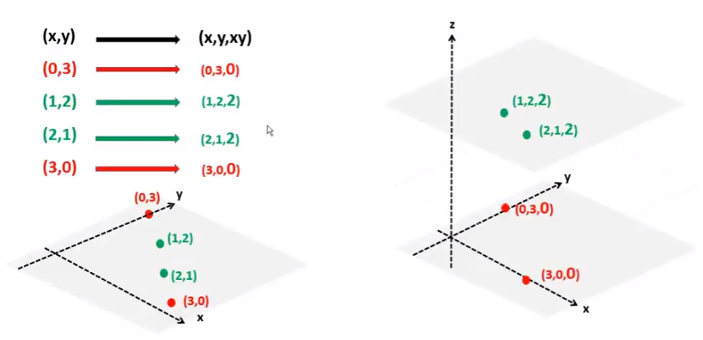
Kernel Trick (SVM)

